Slide 1



Low-Fi Prototype
Team: Laura Brouckman, Matthew Chen, Leslie Kurt, Saamon Legoski
Studio: Digital Democracy
Presenter: Laura Brouckman

Slide 2
Mission/Value Statement
“DeBias yourself with diverse news sources!”

Slide 3
UI Sketches

Slide 4
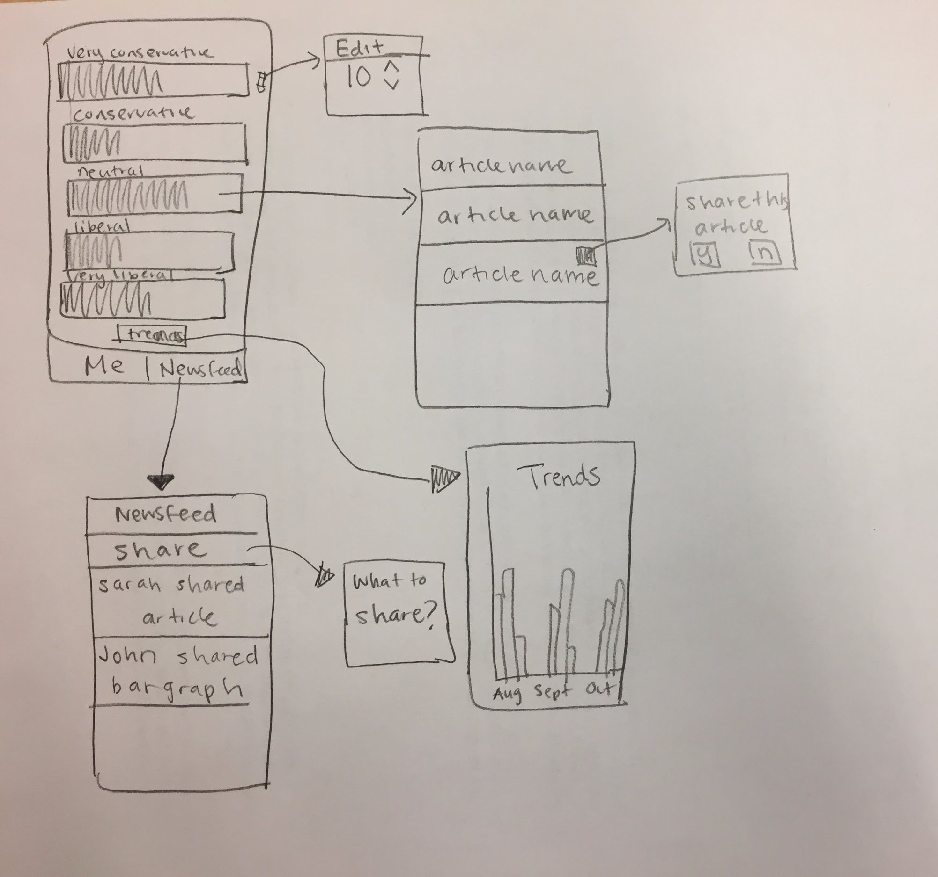
Concept #1: iPhone App

Slide 5
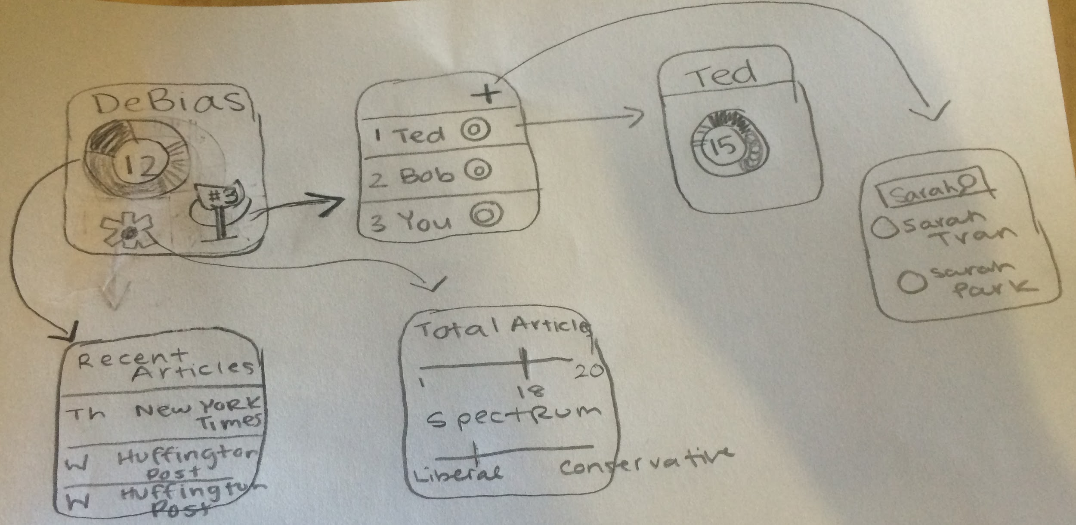
Concept #2: Apple Watch

Slide 6
Selected Interface: #1
Clear layout
Multiple ways to visualize data
Divide between personal side of app and social side of app
Better platform
Data is spread throughout multiple screens
Newsfeed is somewhat boring and does not inspire competition

Slide 7
Tasks

Slide 8
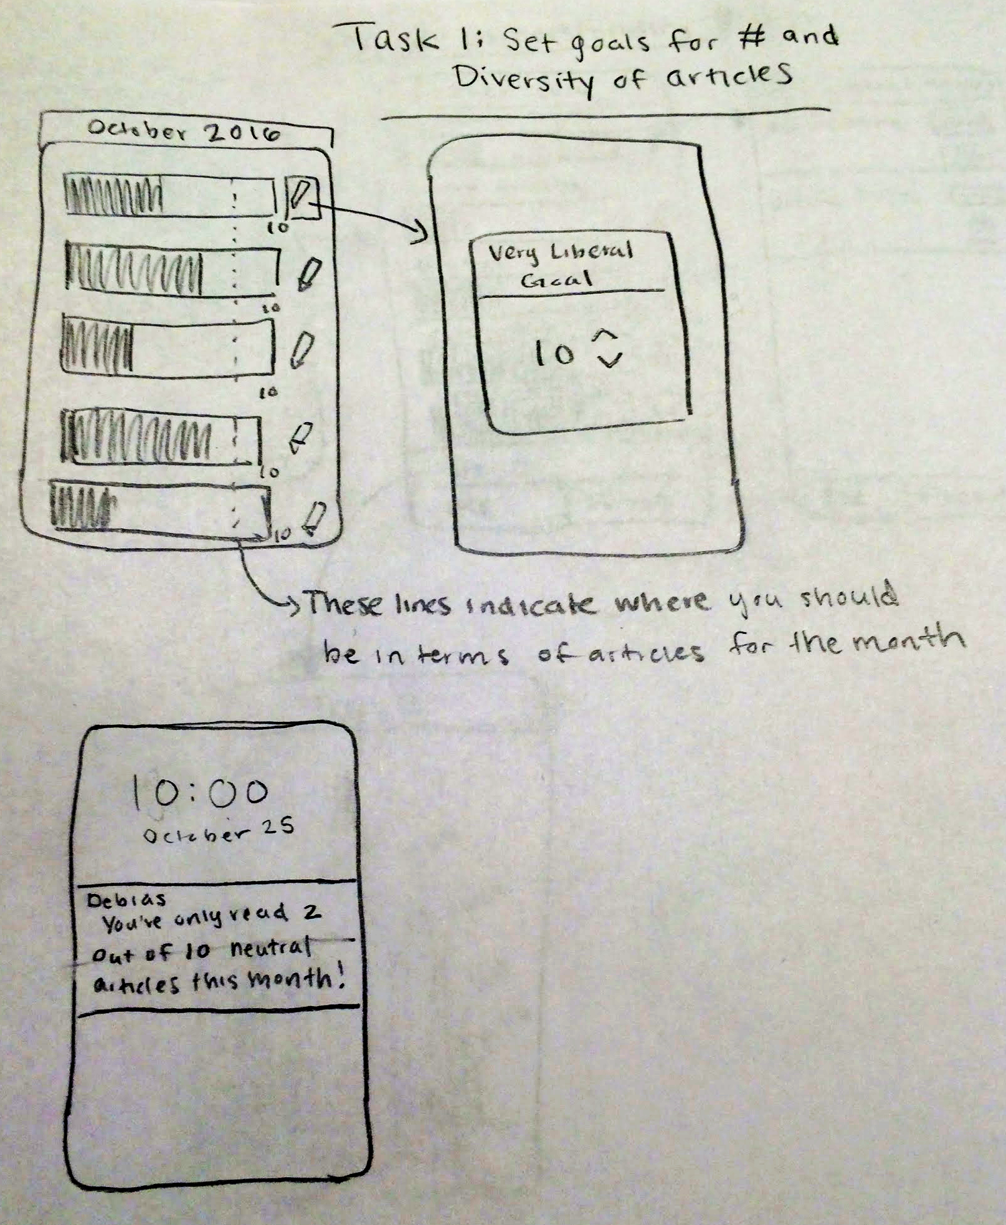
Task #1
Set goals for the number and diversity of articles to read in a week

Slide 9
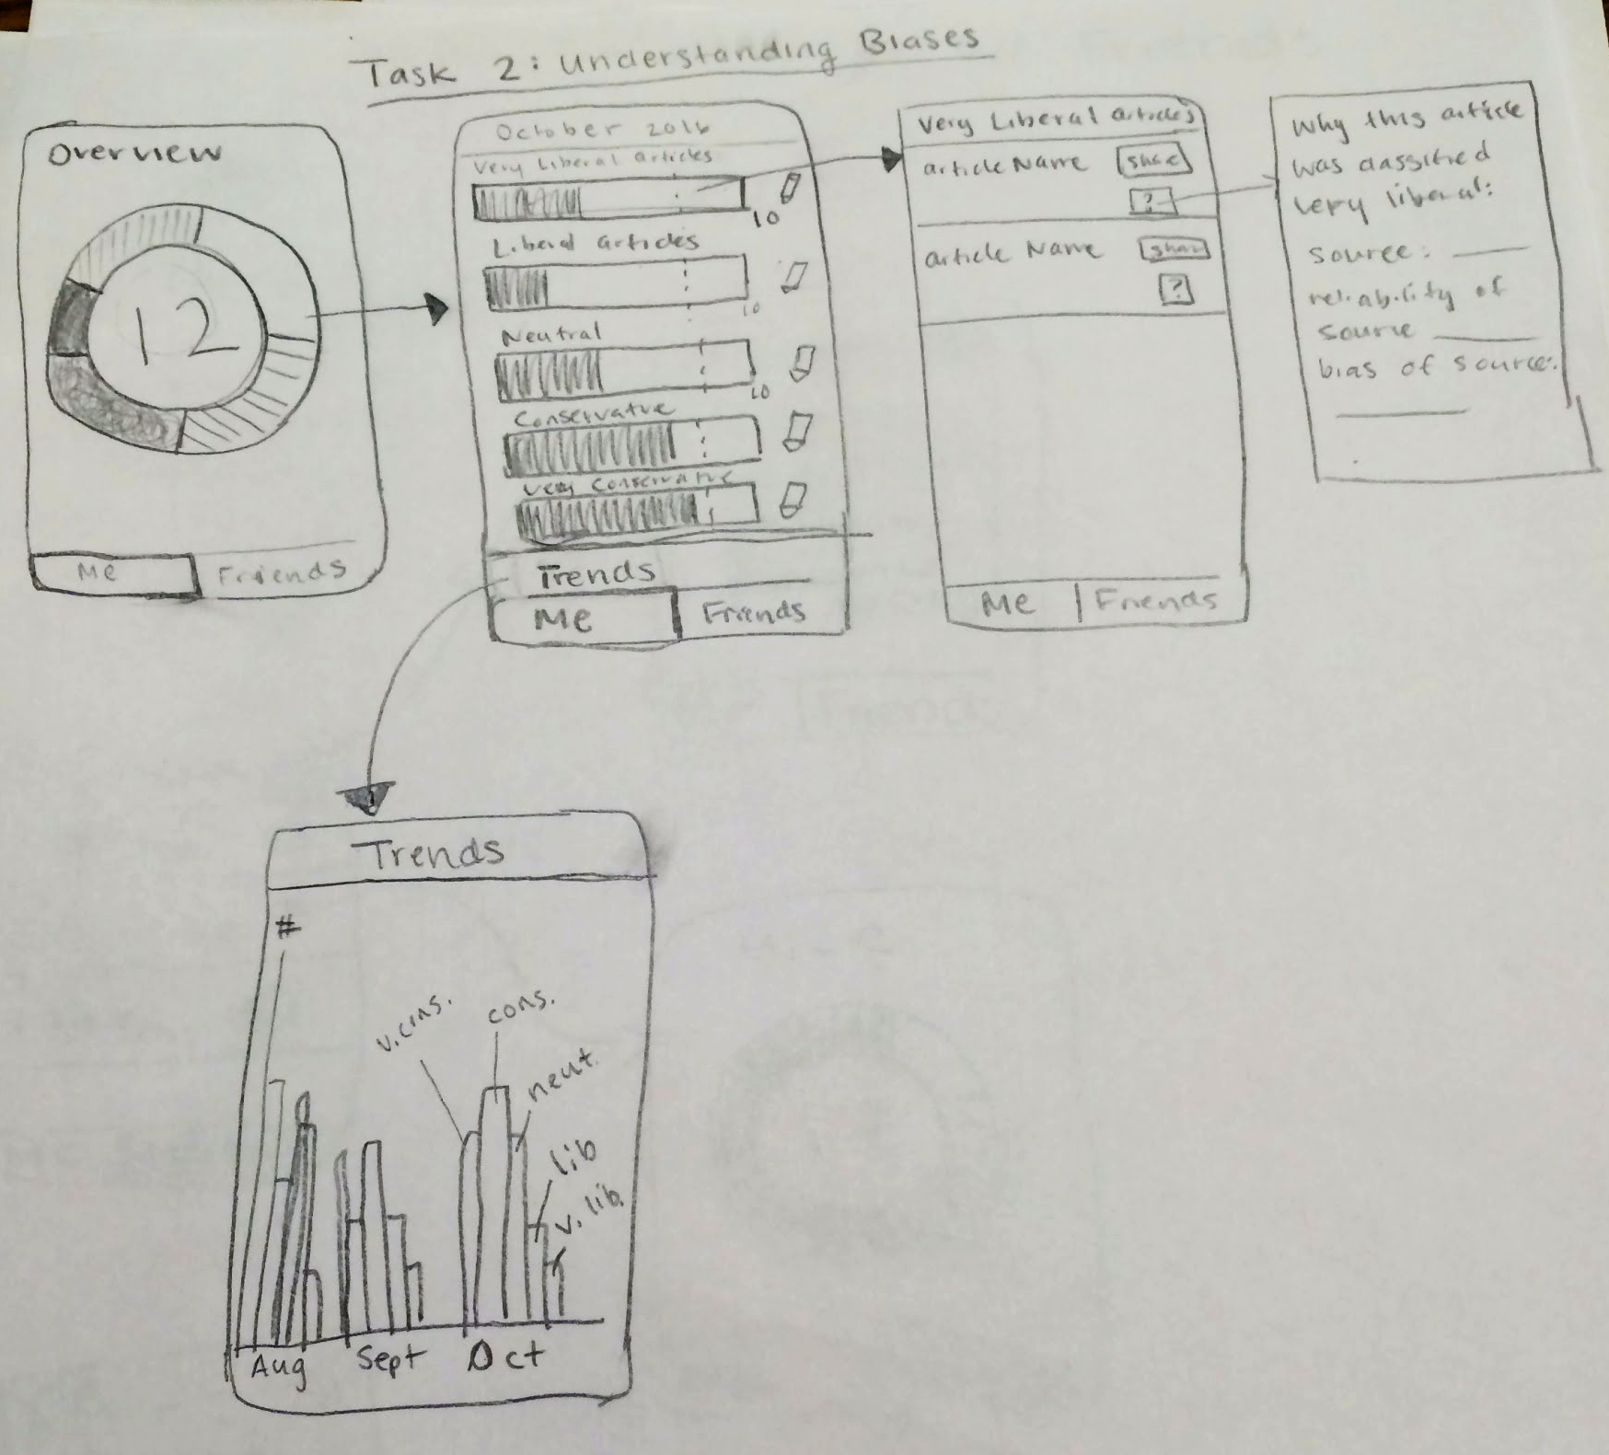
Task #2
Ensure that the user is aware of their own biases

Slide 10
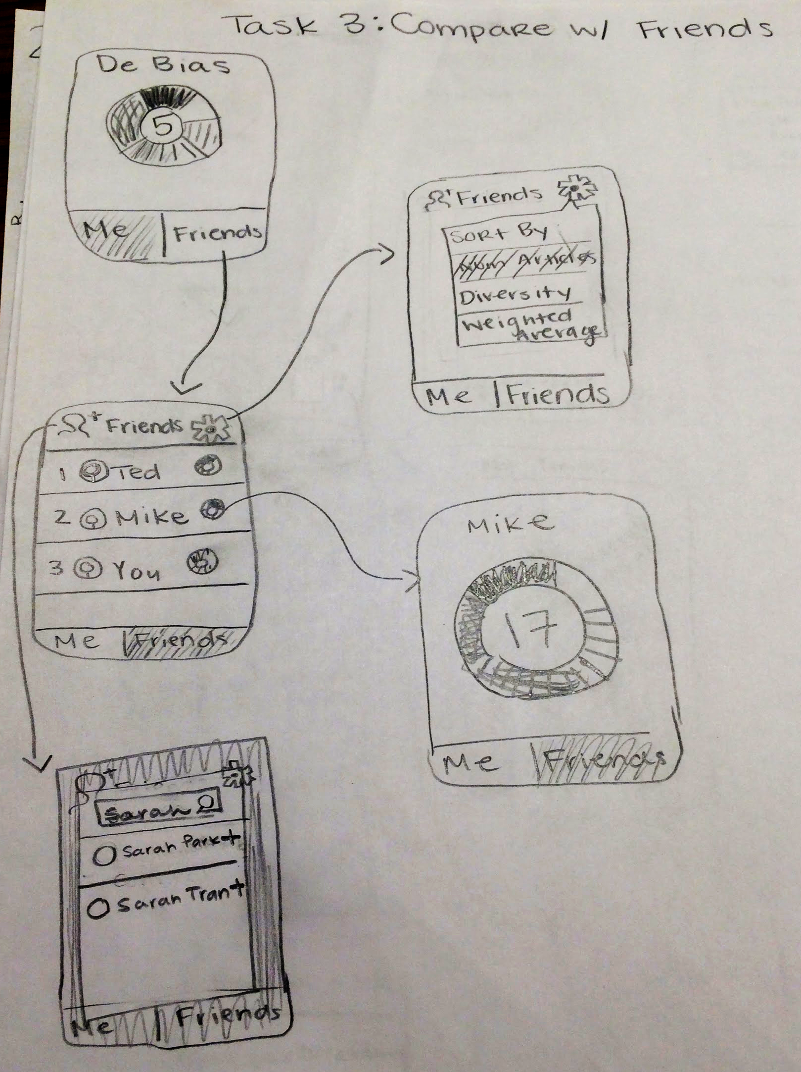
Task #3
Compare and compete with other users

Slide 11
Prototype Structure

Slide 12
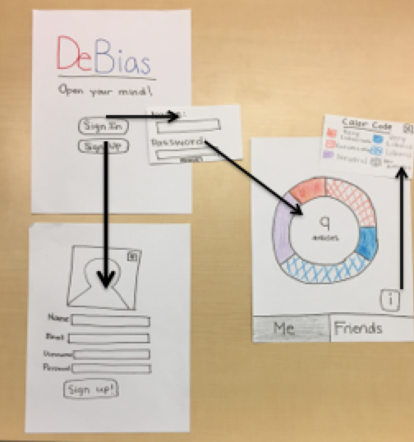
Prototype Structure
Register/ Log-in Interface

Slide 13
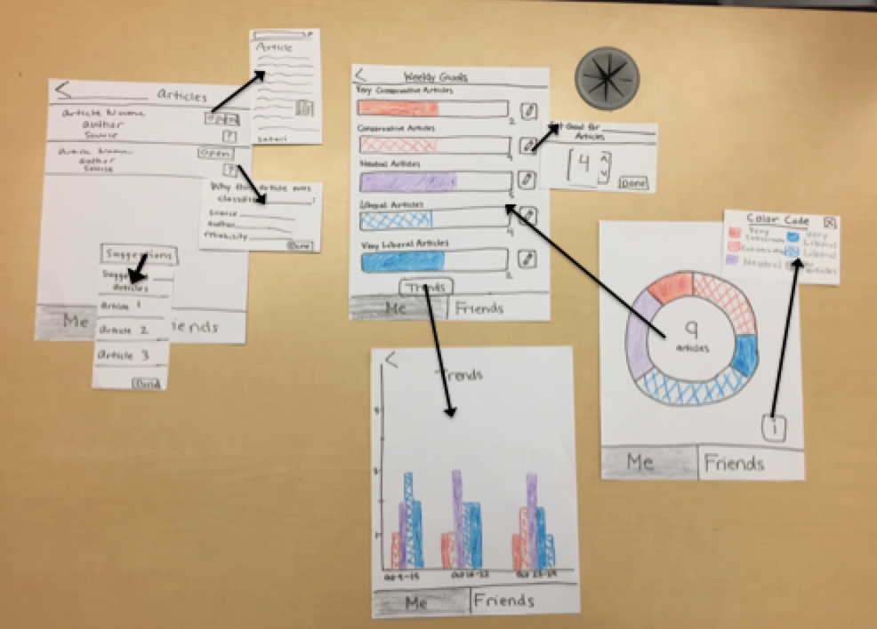
Prototype Structure
View breakdown of news sources
View/ update weekly goals
See specific articles
View your progress over time

Slide 14
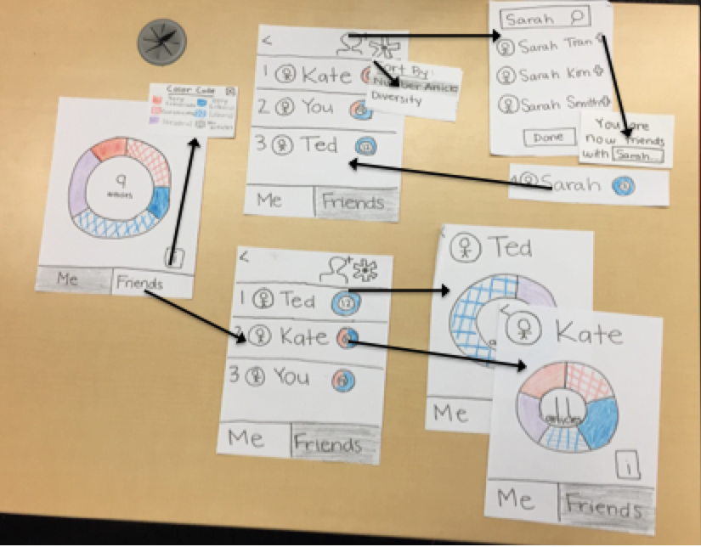
Prototype Structure
Compare with
friends
View your rankings
Add friends
View more information on your friends

Slide 15
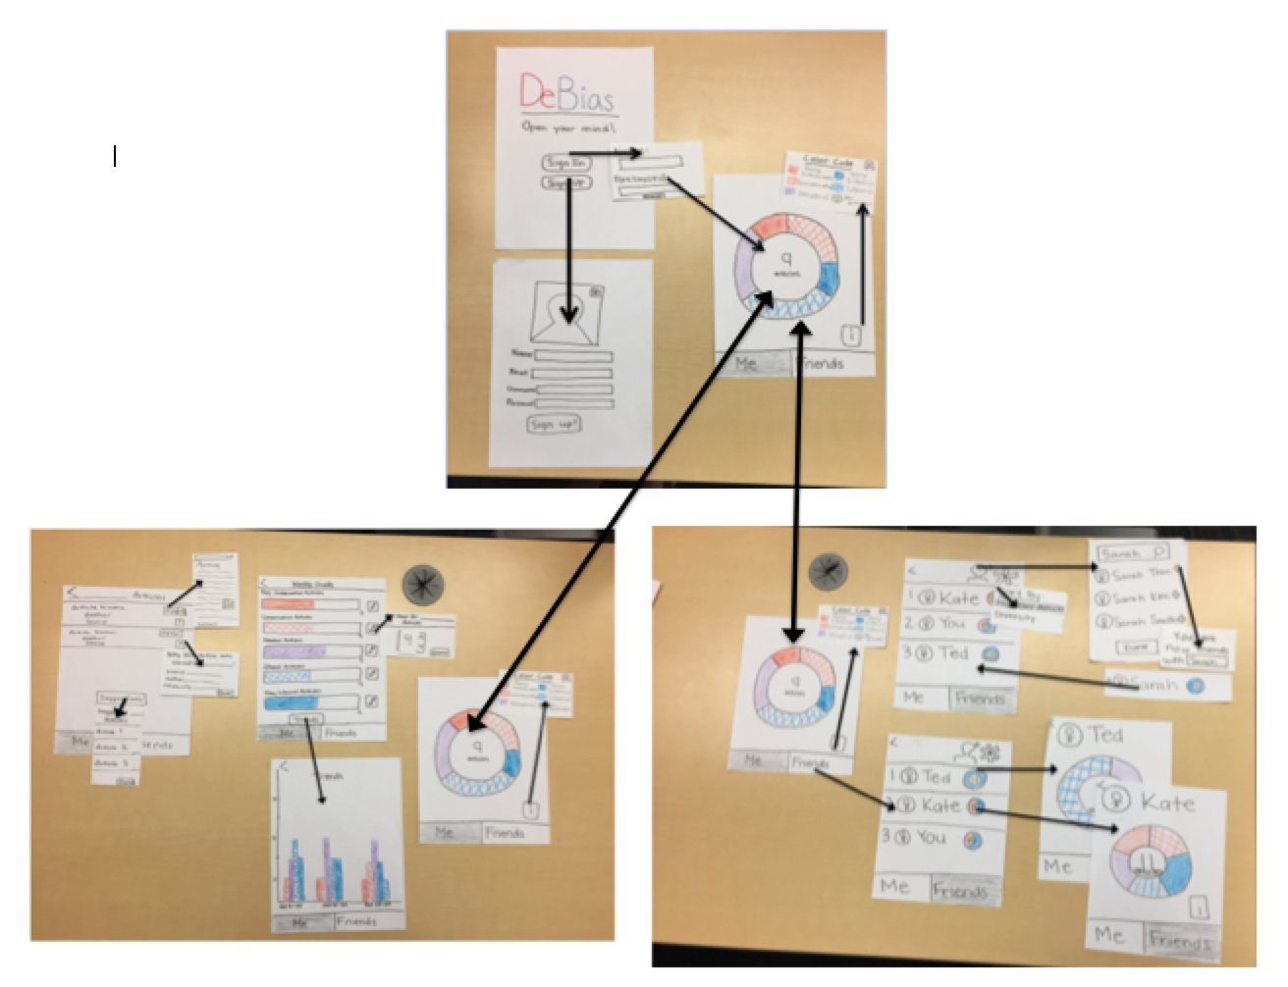
Prototype Structure

Slide 16
Method and Results

Slide 17
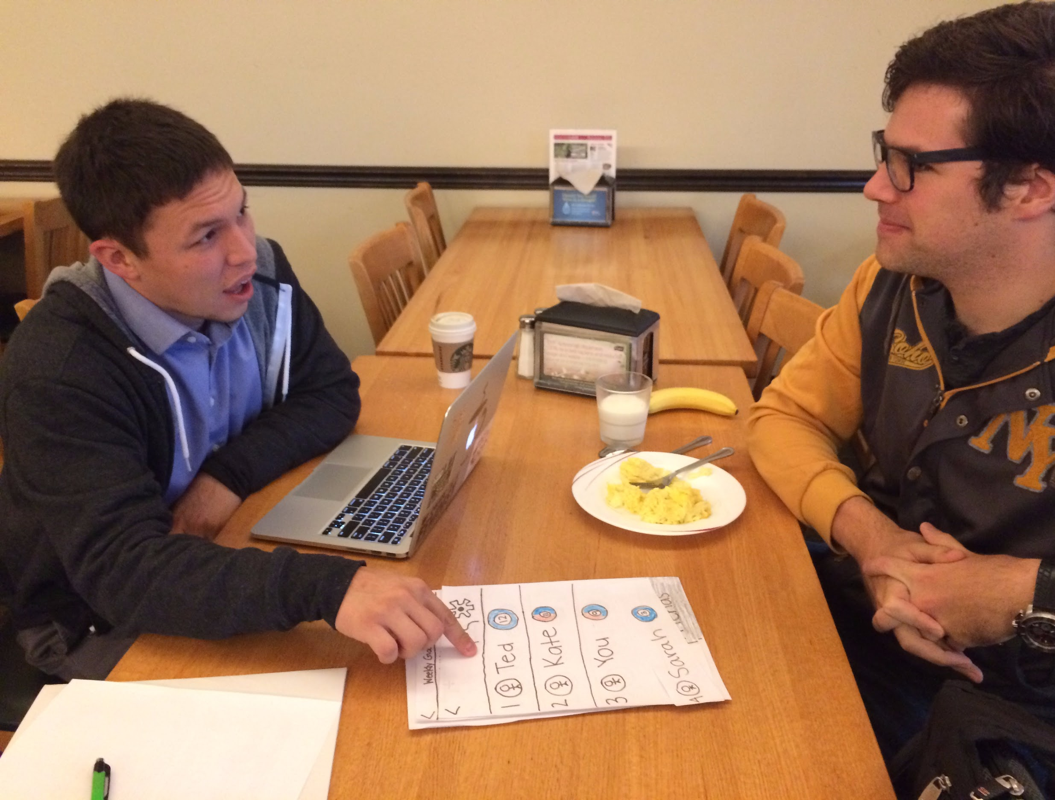

Experimental Methods

Slide 18
Experimental Results
Visual and intuitive interface
Inspired competition between users
Users understood their biases
Users “read” suggested articles
Confusion over initial screen
Icon buttons sometimes surprised users
Notes:
Overall, testing the lo-fi prototype went very well. Most of the feedback received was positive, and the negative feedback was mostly minor usability or cosmetic issues, as well as some suggestions for new features to include. The three users all found the interface very visual and intuitive; all three were able to accomplish the tasks we gave them without difficulty and seemed to enjoy the process. Two users were competitive with their “friends” on the app, saying that they were sad to be only second or third in the rankings and would read more so they could win. This was excellent feedback, as it backed up our hypothesis that competition would inspire users to read a higher quantity and diversity of news.
Some of the negative feedback we received from the app was initial confusion on the opening pie chart screen. Once users figured out what data was being displayed, they intuitively clicked on the pie chart to see more information, but some of them were initially confused about what was being displayed. We also learned that some of our icons could be better chosen; for example the settings icon on the ranking screen doesn’t really convey that it is used to change how people are ranked, and the info icon on the home screen doesn’t indicate that it will show users a color code. One suggestion we received that we may incorporate going forward was the idea of letting users see what articles their friends have read.

Slide 19
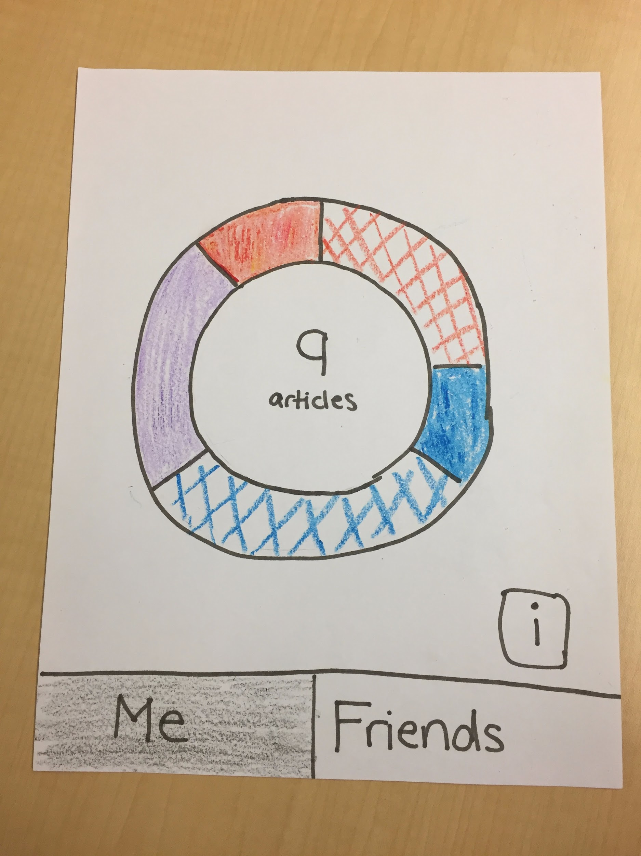
UI Changes
Issue: Users were initially confused by what information this screen showed
Solution: Add in labels to pie chart sections, add walkthrough for first-time users, add in button to take user to detail screens

Slide 20
UI Changes
Issue: Users were initially confused by what information this screen showed
Solution: Add in labels to pie chart sections, add walkthrough for first-time users, add in button to take user to detail screens

Slide 21
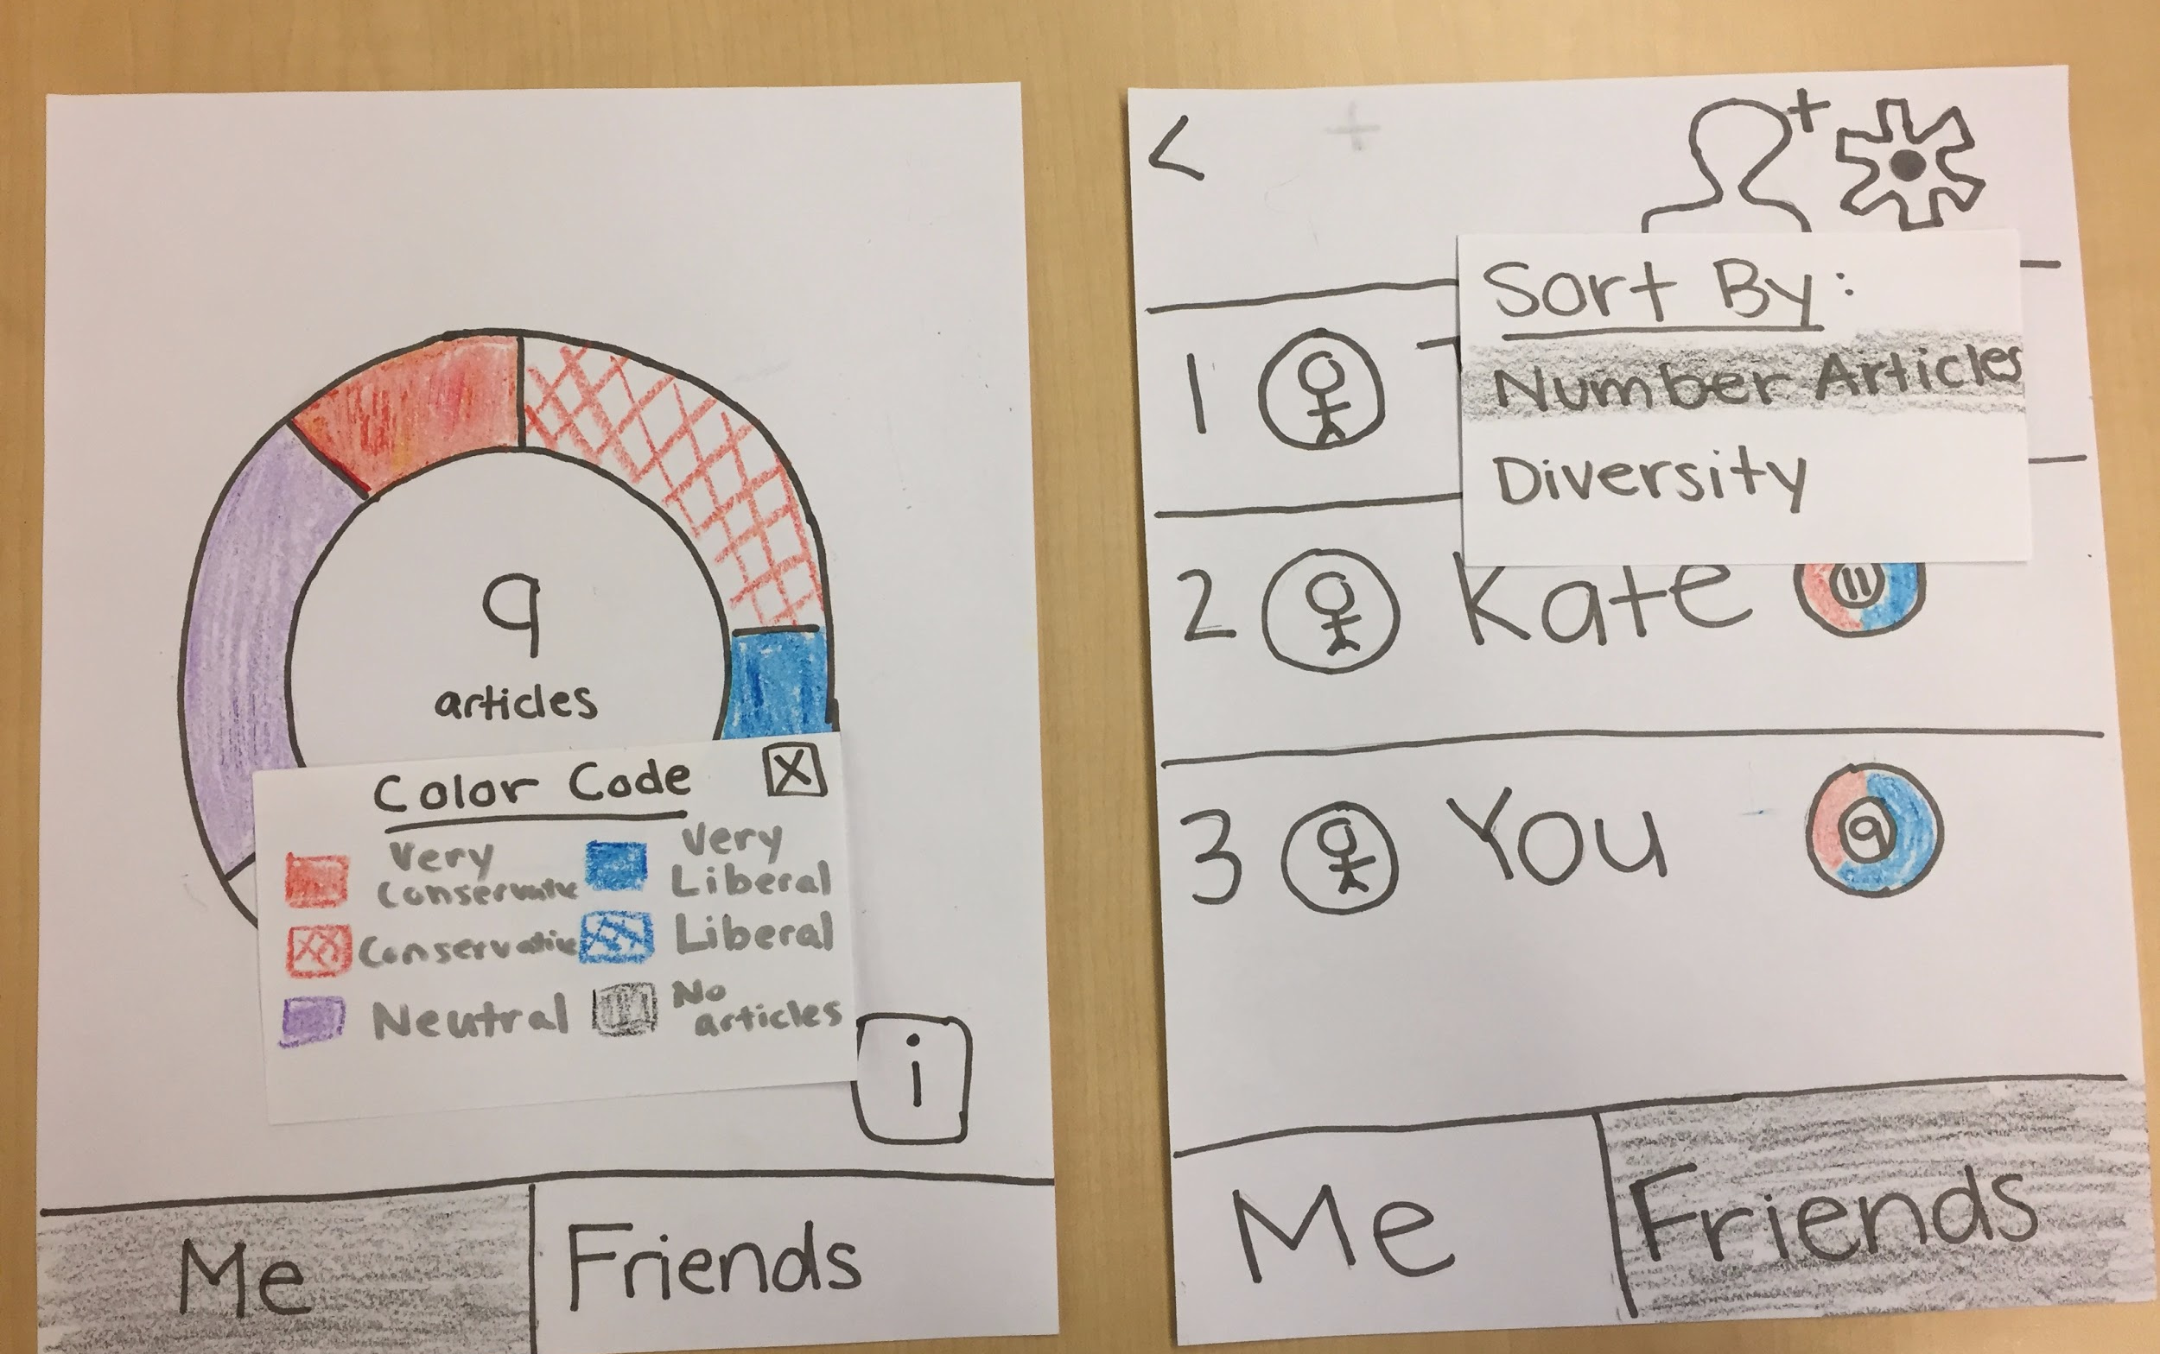
UI Changes
Issue: Some icons were misleading
Solution: Rework icons to be more intuitive

Slide 22
UI Changes
Issue: Some icons were misleading
Solution: Rework icons to be more intuitive

Slide 23
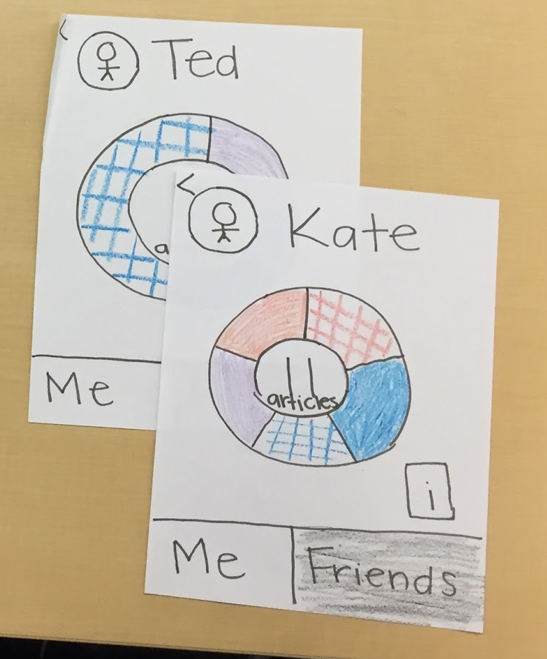
UI Changes
Issue: Users wanted more information about their friends
Solution: Add in a way for users to know what their friends have read, add privacy features so to control who sees user’s article information

Slide 24
UI Changes
Issue: Users wanted more information about their friends
Solution: Add in a way for users to know what their friends have read, add privacy features so to control who sees user’s article information

Slide 25
Key Takeaways
People understood and liked the flow of information
Important to be deliberate with icon images and making clear what is actually clickable
Prototype could not capture the long term aggregation of news

Slide 26
Appendix

Slide 27
Notes

